Slide 1
BCSE102L- Structured and Object-Oriented Programming

Slide 2
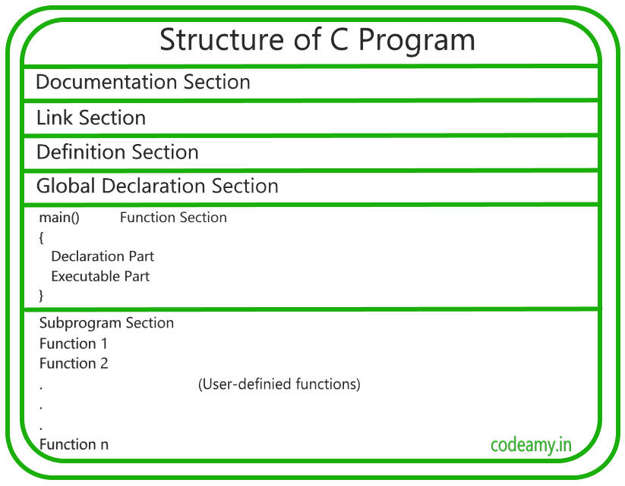

Slide 3
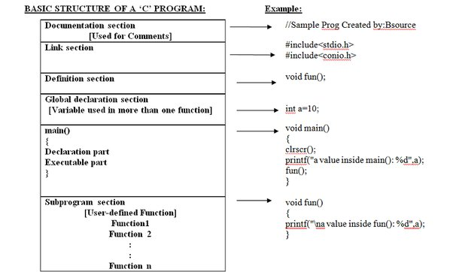

Slide 4
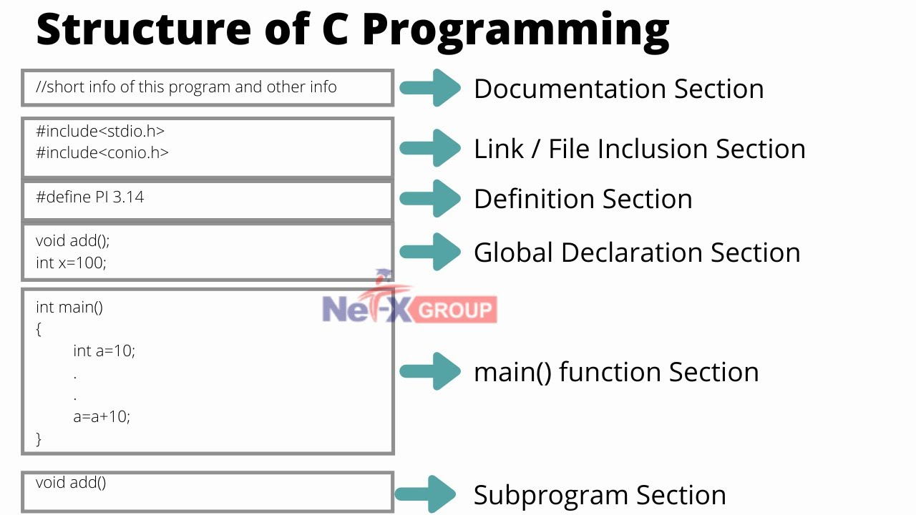

Slide 5
Basic Structure of C Program
Section | Description
Documentation | Includes the program’s description, the programmer’s name, and the creation date. The majority of these are written as comments.
Link | This section includes all header files. A header file is a file that contains C declarations that can be shared among many files. We can use other people’s codes in our files due to it. Before compilation, a copy of these header files is inserted into your code.

Slide 6
Definition | preprocessor directive that contains symbolic constants is included. For instance, #define enables the usage of constants in our code. In the code, it substitutes its value for each constant.
Global Declaration | Includes the declaration of functions, static global variables, and global variable declarations.
Main() Function | Every C program’s main() function serves as the starting point for execution. A main() function must be present in every C program.
Subprograms | All user-defined methods should be included (functions the user provides). Both built-in functions and function definitions specified in the Global Declaration section may be included there. The main() method is what is used for them.

Slide 7
Tokens in C
A token in C can be defined as the smallest individual element of the C programming language that is meaningful to the compiler.
It is the basic component of a C program.

Slide 8
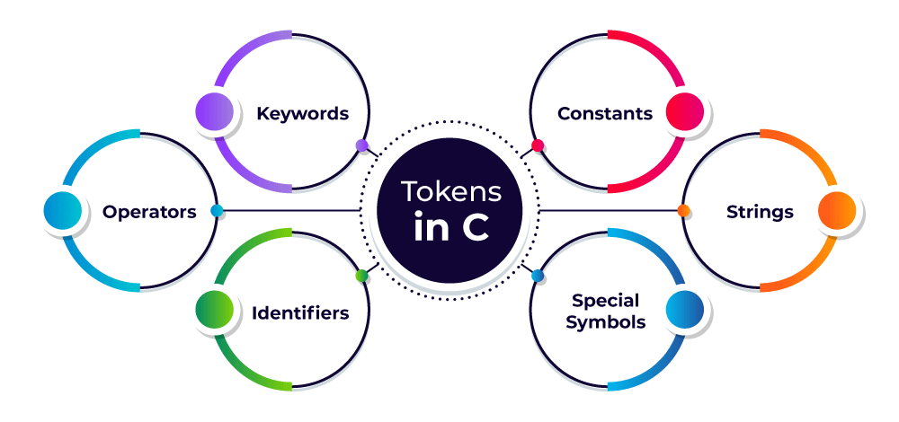
Types of Tokens in C
The tokens of C language can be classified into six types based on the functions they are used to perform. The types of C tokens are as follows:

Slide 9
Keywords
Identifiers
Constants
Strings
Special Symbols
Operators

Slide 10
C Token – Keywords
The keywords are pre-defined or reserved words in a programming language.
Each keyword is meant to perform a specific function in a program. Since keywords are referred names for a compiler, they can’t be used as variable names because by doing so, we are trying to assign a new meaning to the keyword which is not allowed.
You cannot redefine keywords.
However, you can specify the text to be substituted for keywords before compilation by using C preprocessor directives.

Slide 11
C Token – Keywords
C language supports 32 keywords which are given below:
auto double int struct
break else long switch
case enum register typedef
char extern return union
const float short unsigned
continue for signed void
default goto sizeof volatile
do if static while

Slide 12
2. C Token – Identifiers
Identifiers are used as the general terminology for the naming of variables, functions, and arrays.
These are user-defined names consisting of an arbitrarily long sequence of letters and digits with either a letter or the underscore(_) as a first character.
Identifier names must differ in spelling and case from any keywords.
Once declared, you can use the identifier in later program statements to refer to the associated value.
A special identifier called a statement label can be used in goto statements.

Slide 13
Rules for Naming Identifiers
Certain rules should be followed while naming c identifiers which are as follows:
They must begin with a letter or underscore(_).
They must consist of only letters, digits, or underscore. No other special character is allowed.
It should not be a keyword.
It must not contain white space.
It should be up to 31 characters long as only the first 31 characters are significant.
Note: Identifiers are case-sensitive so names like variable and Variable will be treated as different.
For example,
main: method name.
a: variable name.

Slide 14
3. C Token – Constants
The constants refer to the variables with fixed values.
They are like normal variables but with the difference that their values can not be modified in the program once they are defined.
Constants may belong to any of the data types.
Examples of Constants in C
const int c_var = 20;
const int* const ptr = &c_var;

Slide 15
4. C Token – Strings
Strings are nothing but an array of characters ended with a null character (‘\0’).
This null character indicates the end of the string.
Strings are always enclosed in double quotes.
Whereas, a character is enclosed in single quotes in C and C++.
Examples of String
char string[20] = {‘g’, ’e’, ‘e’, ‘k’, ‘s’, ‘f’, ‘o’, ‘r’, ‘g’, ’e’, ‘e’, ‘k’, ‘s’, ‘\0’};
char string[20] = “geeksforgeeks”;
char string [] = “geeksforgeeks”;

Slide 16
5. C Token – Special Symbols
The following special symbols are used in C having some special meaning and thus, cannot be used for some other purpose. Some of these are listed below:
Brackets[]: Opening and closing brackets are used as array element references. These indicate single and multidimensional subscripts.
Parentheses(): These special symbols are used to indicate function calls and function parameters.
Braces{}: These opening and ending curly braces mark the start and end of a block of code containing more than one executable statement.
Comma (, ): It is used to separate more than one statement like for separating parameters in function calls.

Slide 17
Semicolon(;): It is known as a statement terminator. It indicates the end of one logical entity. That’s why each individual statement must be ended with a semicolon.
Asterisk (*): It is used to create a pointer variable and for the multiplication of variables.
Assignment operator(=): It is used to assign values and for logical operation validation.
Pre-processor (#): The preprocessor is a macro processor that is used automatically by the compiler to transform your program before actual compilation.
Period (.): Used to access members of a structure or union.

Slide 18
6. C Token – Operators
Operators are symbols that trigger an action when applied to C variables and other objects. The data items on which operators act are called operands. Depending on the number of operands that an operator can act upon, operators can be classified as follows:
Unary Operators: Those operators that require only a single operand to act upon are known as unary operators.For Example increment and decrement operators
Binary Operators: Those operators that require two operands to act upon are called binary operators. Binary operators can further are classified into:
Arithmetic operators
Relational Operators
Logical Operators
Assignment Operators
Bitwise Operator
Ternary Operator: The operator that requires three operands to act upon is called the ternary operator. Conditional Operator(?) is also called the ternary operator.

Slide 19
C Variables
What is a variable in C?
A variable in C is a memory location with some name that helps store some form of data and retrieves it when required.
We can store different types of data in the variable and reuse the same variable for storing some other data any number of times.
They can be viewed as the names given to the memory location so that we can refer to it without having to memorize the memory address.
The size of the variable depends upon the data type it stores.
A variable definition tells the compiler where and how much storage to create for the variable.

Slide 20
C Variable Syntax
A variable definition specifies a data type and contains a list of one or more variables of that type as follows −
type variable_list;
int i, j, k;
char c, ch;
float f, salary;
double d;

Slide 21
We can also provide values while declaring the variables as given below:
int a=10,b=20;//declaring 2 variable of integer type
float f=20.8;
char c='A';

Slide 22
Rules for defining variables
A variable can have alphabets, digits, and underscore.
A variable name can start with the alphabet, and underscore only.
It can't start with a digit.
No whitespace is allowed within the variable name.
A variable name must not be any reserved word or keyword, e.g. int, float, etc.

Slide 23
Valid variable names:
int a;
int _ab;
int a30;
Invalid variable names:
int 2;
int a b;
int long;

Slide 24
Types of Variables in C
There are many types of variables in c:
local variable
global variable
static variable
automatic variable
external variable

Slide 25
Local Variable
A variable that is declared inside the function or block is called a local variable.
It must be declared at the start of the block.
void function1()
{
int x=10;//local variable
}

Slide 26
Global Variable
A variable that is declared outside the function or block is called a global variable.
Any function can change the value of the global variable. It is available to all the functions.
It must be declared at the start of the block.
int value=20;//global variable
void function1(){
int x=10;//local variable
}

Slide 27
Static Variable
A variable that is declared with the static keyword is called static variable.
It retains its value between multiple function calls.
void function1(){
int x=10;//local variable
static int y=10;//static variable
x=x+1;
y=y+1;
printf("%d,%d",x,y);
}

Slide 28
Automatic Variable
All variables in C that are declared inside the block, are automatic variables by default.
We can explicitly declare an automatic variable using auto keyword.
void main(){
int x=10;//local variable (also automatic)
auto int y=20;//automatic variable
}

Slide 29
External Variable
We can share a variable in multiple C source files by using an external variable. To declare an external variable, you need to use extern keyword.
myfile.h
extern int x=10;
//external variable (also global)
program1.c
#include "myfile.h"
#include <stdio.h>
void printValue(){
printf("Global variable: %d", global_variable);
}

Slide 30
Data Types in C
Each variable in C has an associated data type. It specifies the type of data that the variable can store like integer, character, floating, double, etc.
Each data type requires different amounts of memory and has some specific operations which can be performed over it.
The data type is a collection of data with values having fixed values, meaning as well as its characteristics.

Slide 31
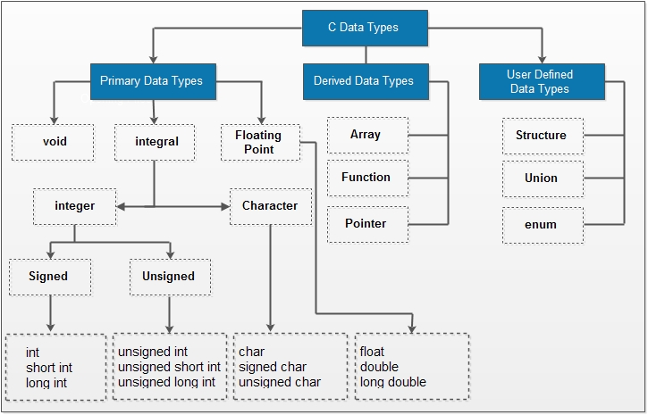

Slide 32
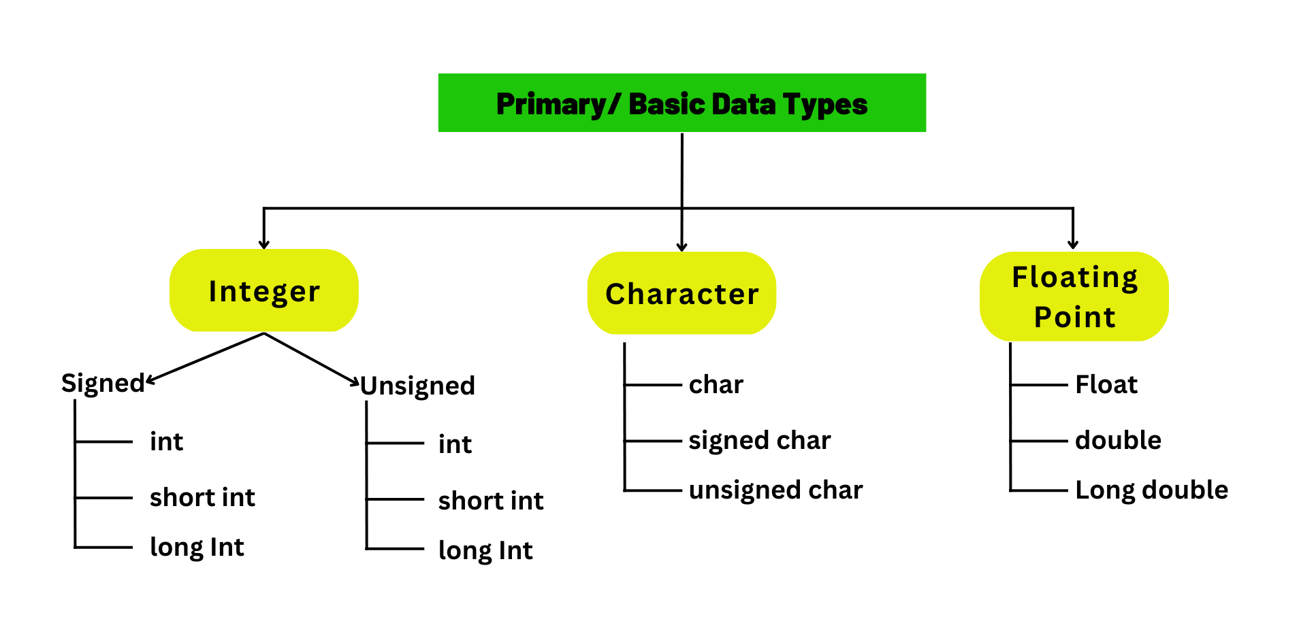

Slide 33
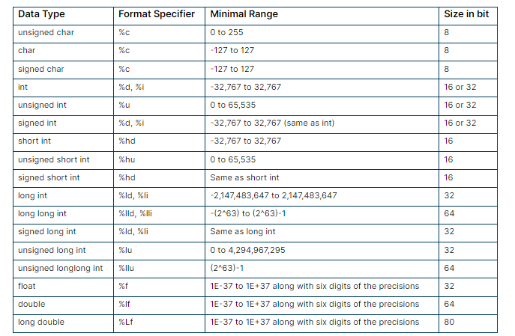

Slide 34
Char:
Individual characters are represented by the char data type.
Typically used to hold ASCII or UTF-8 encoding scheme characters, such as letters, numbers, symbols, or commas.
There are 256 characters that can be represented by a single char, which takes up one byte of memory.
Characters such as 'A', 'b', '5', or '$' are enclosed in single quotes.

Slide 35
Float:
To represent integers, use the floating data type. Floating numbers can be used to represent fractional units or numbers with decimal places.
The float type is usually used for variables that require very good precision but may not be very precise. It can store values with an accuracy of about 6 decimal places and a range of about 3.4 x 1038 in 4 bytes of memory.

Slide 36
Double:
Use two data types to represent two floating integers. When additional precision is needed, such as in scientific calculations or financial applications, it provides greater accuracy compared to float.
Double type, which uses 8 bytes of memory and has an accuracy of about 15 decimal places, yields larger values. C treats floating point numbers as doubles by default if no explicit type is supplied.

Slide 37
int age = 25;
char grade = 'A';
float temperature = 98.6;
double pi = 3.14159265359;
In the example above, we declare four variables: an int variable for the person's age, a char variable for the student's grade, a float variable for the temperature reading, and two variables for the number pi.

Slide 38
#include <stdio.h>
int main() {
short a;
long b;
long long c;
long double d;
printf("size of short = %d bytes\n", sizeof(a));
printf("size of long = %d bytes\n", sizeof(b));
printf("size of long long = %d bytes\n", sizeof(c));
printf("size of long double= %d bytes\n", sizeof(d));
return 0;
}

Slide 39
void
void is an incomplete type. It means "nothing" or "no type". You can think of void as absent.
For example, if a function is not returning anything, its return type should be void.
Note that, you cannot create variables of void type.

Slide 40
printf() and scanf() in C
printf() function
The printf() function is used for output. It prints the given statement to the console.
The syntax of printf() function is given below:
printf("format string",argument_list);
The format string can be %d (integer), %c (character), %s (string), %f (float) etc.

Slide 41
Parameters
formatted_string: It is a string that specifies the data to be printed.
It may also contain a format specifier to print the value of any variable such as a character and an integer.
arguments_list: These are the variable names corresponding to the format specifier.

Slide 42
1. Specifier
It is the character that denotes the type of data. Some commonly used specifiers are:
%d: for printing integers
%f: for printing floating-point numbers
%c: for printing characters
%s: for printing strings
%p: for printing memory addresses
%x: for printing hexadecimal values
Example
printf("%c", char_variable);

Slide 43
#include <stdio.h>
int main() {
short a;
long b;
long long c;
long double d;
printf("size of short = %d bytes\n", sizeof(a));
printf("size of long = %d bytes\n", sizeof(b));
printf("size of long long = %d bytes\n", sizeof(c));
printf("size of long double= %d bytes\n", sizeof(d));
return 0;
}
size of short = 2 bytes
size of long = 8 bytes
size of long long = 8 bytes
size of long double= 16 bytes

Slide 44
scanf() function
The scanf() function is used for input. It reads the input data from the console.
scanf("format string",argument_list);

Slide 45
Program to print cube of given number
#include<stdio.h>
int main(){
int number;
printf("enter a number:");
scanf("%d",&number);
printf("cube of number is:%d ",number*number*number);
return 0;
}

Slide 46
#include<stdio.h>
int main(){
int x=0,y=0,result=0;
printf("enter first number:");
scanf("%d",&x);
printf("enter second number:");
scanf("%d",&y);
result=x+y;
printf("sum of 2 numbers:%d ",result);
return 0;
}

Slide 47
Syntax of Format Specifier
%[flags][width][.precision][length]specifier

Slide 48
Precision
float myFloatNum = 3.5; double myDoubleNum = 19.99; printf("%f\n", myFloatNum); // Outputs 3.500000 printf("%lf", myDoubleNum); // Outputs 19.990000

Slide 49
Precision
float myFloatNum = 3.5; printf("%f\n", myFloatNum); // Default will show 6 digits after the decimal point printf("%.1f\n", myFloatNum); // Only show 1 digit printf("%.2f\n", myFloatNum); // Only show 2 digits printf("%.4f", myFloatNum); // Only show 4 digits

Slide 50
Precision
Precision subspecifier meaning differs for different format specifiers it is being used with.
For Integral data(d, i, u, o, x): Specifies the minimum number of digits to be printed.
But unlike the width sub-specifier, instead of white spaces, this sub-specifier adds leading zeroes to the number.
If the number has more digits than the precision, the number is printed as it is.
For Float or Double Data(f, e, a, A): Specifies the number of digits to be printed after the decimal point.
For String (s): Specifies the length of the string to be printed.
Example
printf("%.10d", some_integer);
printf("%.3f", some_float);
printf("%.25s", some_string);

Slide 51
Example 3: printf with Precision Sub-Specifier
// C program to illustrate the use of precision
// sub-specifier
#include <stdio.h>
int main()
{
int num = 2451;
float dec = 12.45126;
char* arr = "GeeksforGeeks";
// precision for integral data
printf("For integers: %.10d\n", num);
// precision for numbers with decimal points
printf("For floats: %.2f\n", dec);
// for strings
printf("For strings: %.5s", arr);
return 0;
}

Slide 52
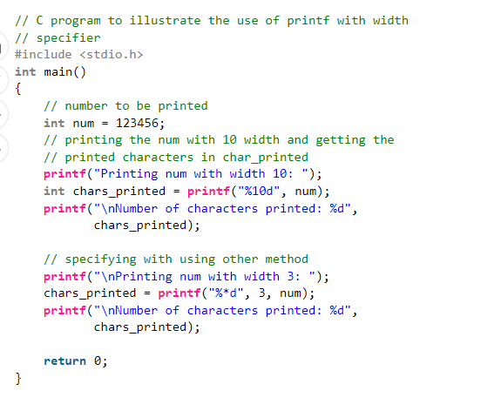

Slide 53
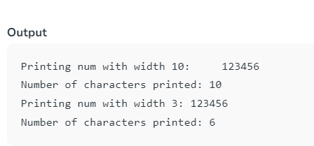

Slide 54
C - Operators
An operator is a symbol that tells the compiler to perform specific mathematical or logical functions. C language is rich in built-in operators and provides the following types of operators −
Arithmetic Operators
Relational Operators
Logical Operators
Bitwise Operators
Assignment Operators
Misc Operators

Slide 55
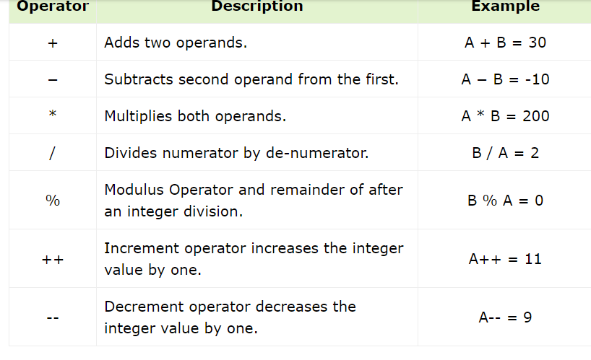
Arithmetic Operators
Assume variable A holds 10 and variable B holds 20

Slide 56
#include <stdio.h>
main() {
int a = 21, b = 10, c ;
c = a + b;
printf("Line 1 - Value of c is %d\n", c );
c = a - b;
printf("Line 2 - Value of c is %d\n", c );
c = a * b;
printf("Line 3 - Value of c is %d\n", c );
c = a / b;
printf("Line 4 - Value of c is %d\n", c );
c = a % b;
printf("Line 5 - Value of c is %d\n", c );
c = a++;
printf("Line 6 - Value of c is %d\n", c );
c = a--;
printf("Line 7 - Value of c is %d\n", c );
}

Slide 57
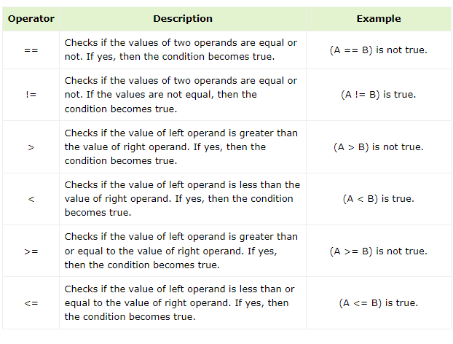
Relational Operators
A=10 and B=20

Slide 58
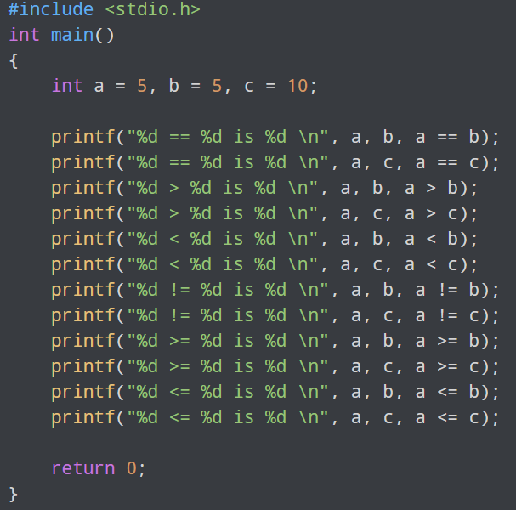
Relational Operators

Slide 59
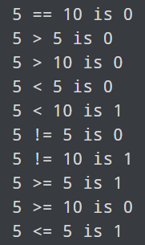
Relational Operators

Slide 60
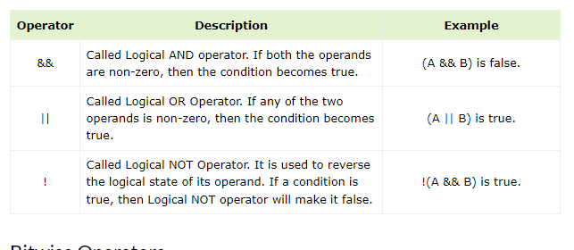
Logical Operators
Assume variable A holds 1 and variable B holds 0, then −

Slide 61
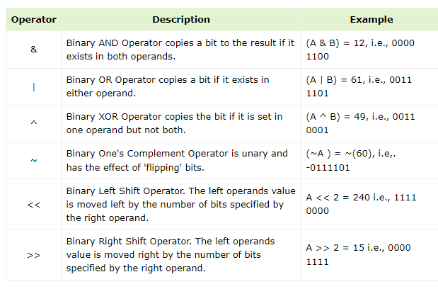
Bitwise Operators
Assume variable 'A' holds 60 and variable 'B' holds 13

Slide 62
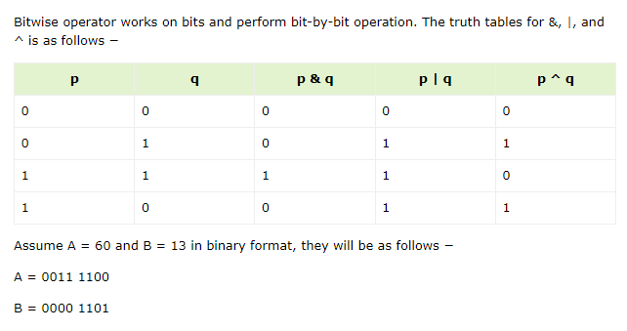

Slide 63
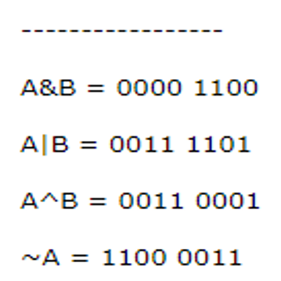
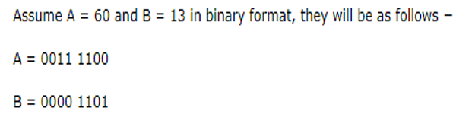
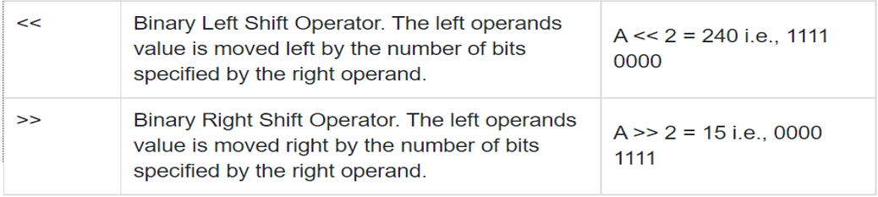

Slide 64
Bitwise Complement Operator
Bitwise complement operator is a unary operator (works on only one operand). It changes 1 to 0 and 0 to 1. It is denoted by ~.
35 = 00100011 (In Binary) Bitwise complement Operation of 35 ~
00100011
________
11011100 = 220 (In decimal)

Slide 65
Twist in Bitwise Complement Operator in C Programming
The bitwise complement of 35 (~35) is -36 instead of 220, but why?
For any integer n, bitwise complement of n will be -(n + 1). To understand this, you should have the knowledge of 2's complement.

Slide 66
#include <stdio.h>
int main ()
{
// declare local variable
int num, bit;
printf (" Enter a positive number: ");
scanf (" %d", &num);
printf (" No. of binary bits shifted to the right side: ");
scanf (" %d", &bit);
// use right shift operator to shift the bits
num = (num >> bit);
printf (" \n After using the right shift operator to shift the bits at the right side. ");
printf (" \n New value of the num = %d", num);
return 0;
}

Slide 67
#include <stdio.h>
int main ()
{
// declare local variable
int num;
printf (" Enter a positive number: ");
scanf (" %d", &num);
// use right shift operator to shift the bits
num = (num >> 2); // It shifts two bits at the right side
printf (" \n After shifting the binary bits to the right side. ");
printf (" \n The new value of the variable num = %d", num);
return 0;
}

Slide 68
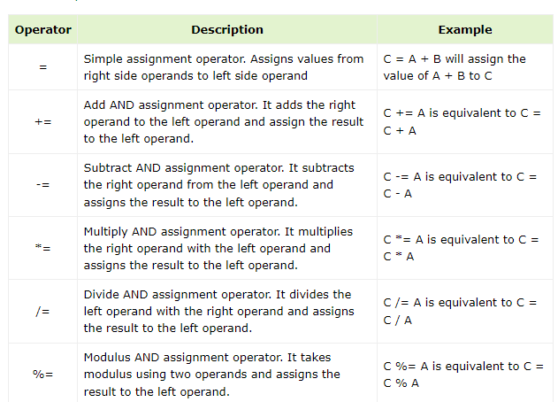
Assignment Operators

Slide 69
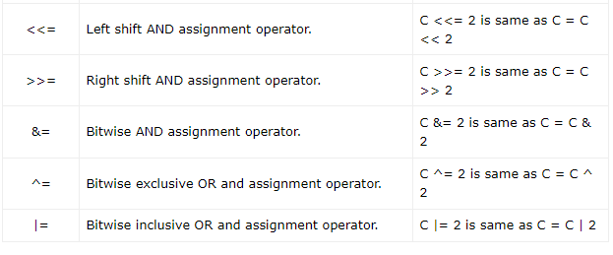

Slide 70
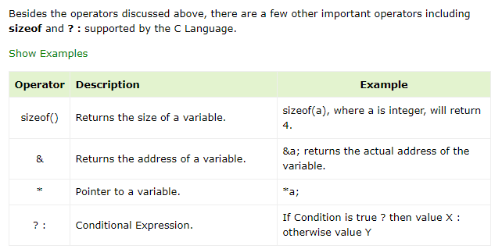
Misc Operators ↦ sizeof & ternary

Slide 71
#include <stdio.h>
main() {
int a = 4;
short b;
double c;
int* ptr;
/* example of sizeof operator */
printf("Line 1 - Size of variable a = %d\n", sizeof(a) );
printf("Line 2 - Size of variable b = %d\n", sizeof(b) );
printf("Line 3 - Size of variable c= %d\n", sizeof(c) );
/* example of & and * operators */
ptr = &a; /* 'ptr' now contains the address of 'a'*/
printf("value of a is %d\n", a);
printf("*ptr is %d.\n", *ptr);
/* example of ternary operator */
a = 10;
b = (a == 1) ? 20: 30;
printf( "Value of b is %d\n", b );
b = (a == 10) ? 20: 30;
printf( "Value of b is %d\n", b );
}

Slide 72
#include <stdio.h>
main() {
int a = 21;
int c ;
c = a;
printf("Line 1 - = Operator Example, Value of c = %d\n", c );
c += a;
printf("Line 2 - += Operator Example, Value of c = %d\n", c );
c -= a;
printf("Line 3 - -= Operator Example, Value of c = %d\n", c );
c *= a;
printf("Line 4 - *= Operator Example, Value of c = %d\n", c );
c /= a;
printf("Line 5 - /= Operator Example, Value of c = %d\n", c );

Slide 73
c = 200;
c %= a;
printf("Line 6 - %= Operator Example, Value of c = %d\n", c );
c <<= 2;
printf("Line 7 - <<= Operator Example, Value of c = %d\n", c );
c >>= 2;
printf("Line 8 - >>= Operator Example, Value of c = %d\n", c );
c &= 2;
printf("Line 9 - &= Operator Example, Value of c = %d\n", c );
c ^= 2;
printf("Line 10 - ^= Operator Example, Value of c = %d\n", c );
c |= 2;
printf("Line 11 - |= Operator Example, Value of c = %d\n", c );
}

Slide 74
Operators Precedence in C
Operator precedence determines the grouping of terms in an expression and decides how an expression is evaluated. Certain operators have higher precedence than others; for example, the multiplication operator has a higher precedence than the addition operator.
For example, x = 7 + 3 * 2; here, x is assigned 13, not 20 because operator * has a higher precedence than +, so it first gets multiplied with 3*2 and then adds into 7.
Here, operators with the highest precedence appear at the top of the table, those with the lowest appear at the bottom. Within an expression, higher precedence operators will be evaluated first.

Slide 75
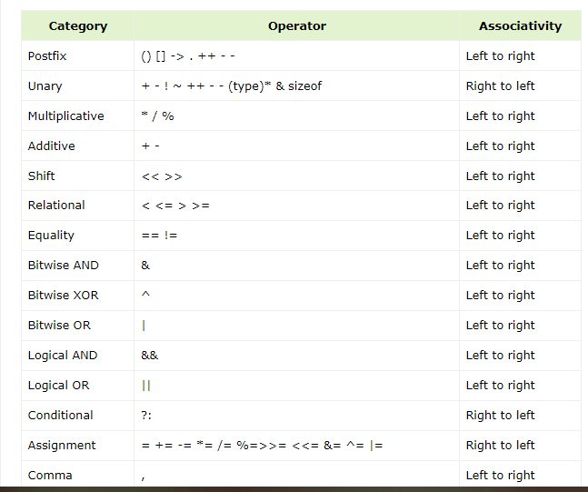

Slide 76
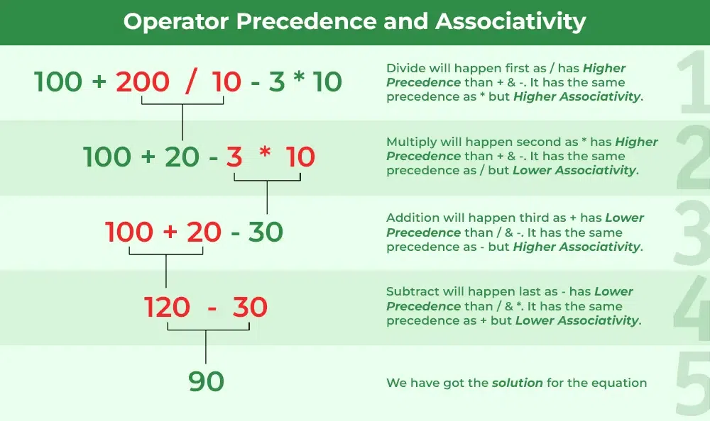

Slide 77
